Slide 1
Building layouts https://flutter.dev/docs/development/ui/layout/tutorial
Notes:
StatelessWidget is used for immutable elements that only rely on the object configuration information
StatefulWidget is used for elements that can dynamically change based on state-changes in the system
Everytime that state changes, setChange() is called by the object

Slide 2
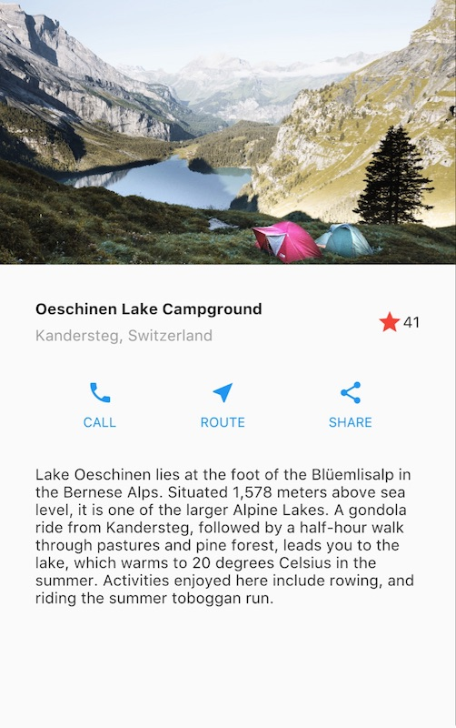
What you’ll learn
How Flutter’s layout mechanism works.
How to lay out widgets vertically and horizontally.
How to build a Flutter layout.
You’ll build the layout for the following app:

Slide 3
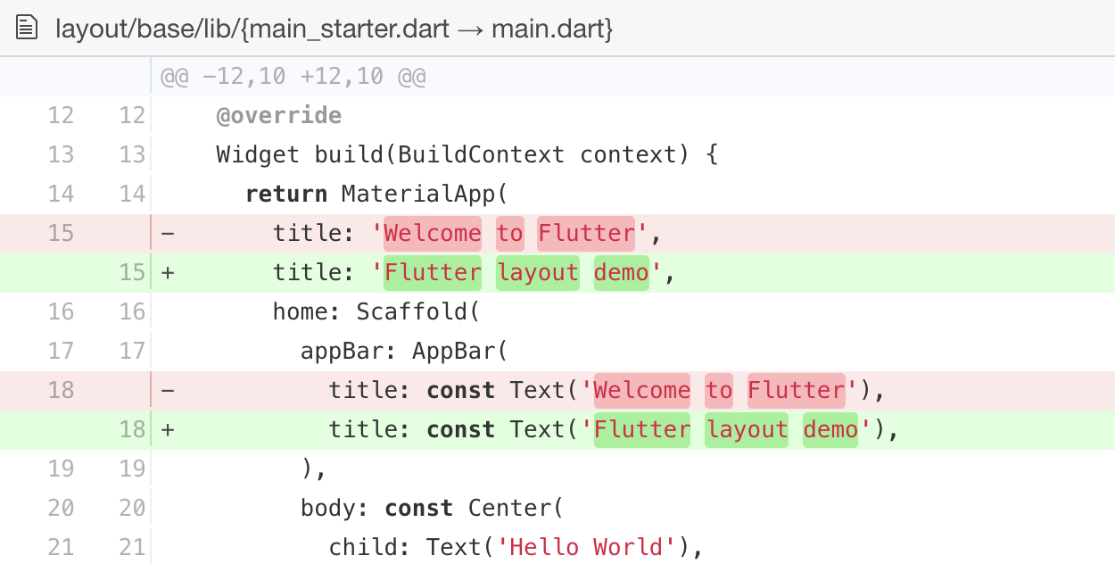
Step 0: Create the app base code
Make sure to set up your environment, then do the following:
Create a basic “Hello World” Flutter app.
Change the app bar title and the app title as follows:

Slide 4
Step 1: Diagram the layout
The first step is to break the layout down to its basic elements:
Identify the rows and columns.
Does the layout include a grid?
Are there overlapping elements?
Does the UI need tabs?
Notice areas that require alignment, padding, or borders.

Slide 5
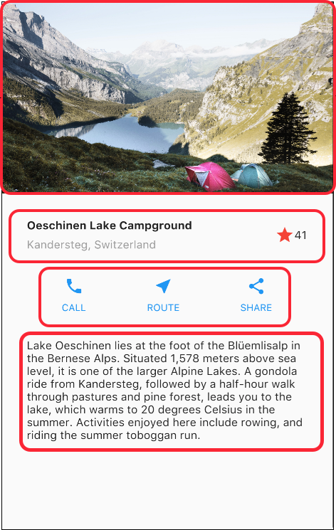
Step 1: Diagram the layout
First, identify the larger elements.
In this example, four elements are arranged into a column: an image, two rows, and a block of text.

Slide 6
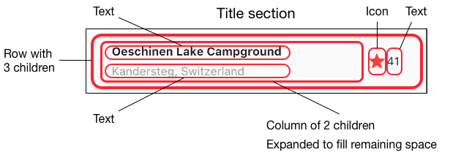
Step 1: Diagram the layout
Next, diagram each row.
The first row, called the Title section, has 3 children: a column of text, a star icon, and a number.

Slide 7
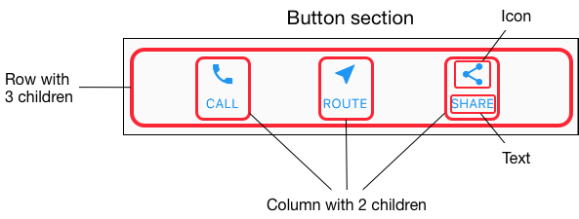
Step 1: Diagram the layout
The second row, called the Button section, also has 3 children: each child is a column that contains an icon and text..

Slide 8
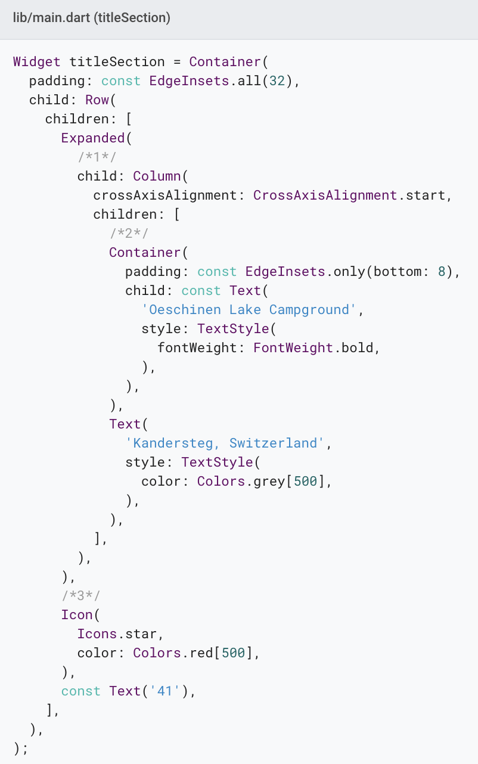
Step 2: Implement the title row
First, you’ll build the left column in the title section.
Add the following code at the top of the build() method of the MyApp class:

Slide 9
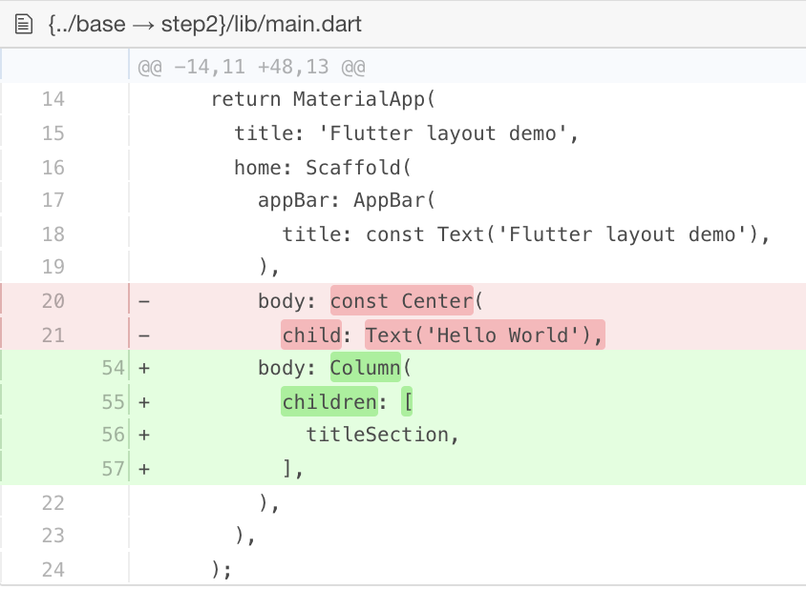
Step 2: Implement the title row
First, you’ll build the left column in the title section.
Add the following code at the top of the build() method of the MyApp class:

Slide 10
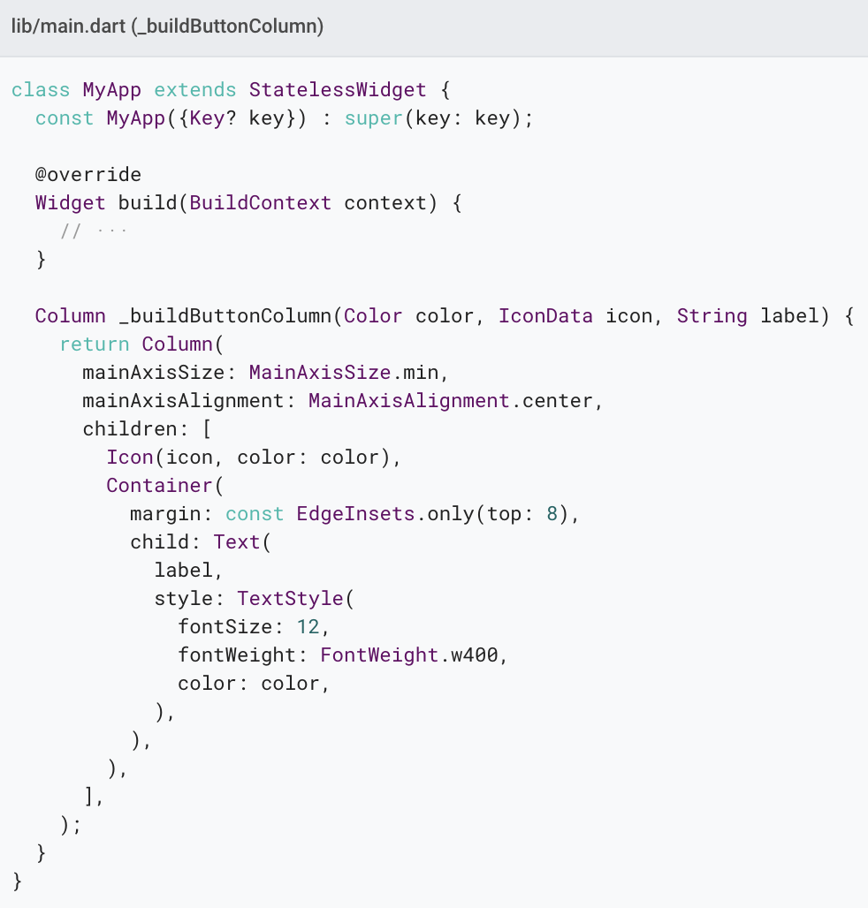
Step 3: Implement the button row
Since the code for building each column is almost identical, create a private helper method named buildButtonColumn(), which takes a color, an Icon and Text, and returns a column with its widgets painted in the given color.

Slide 11
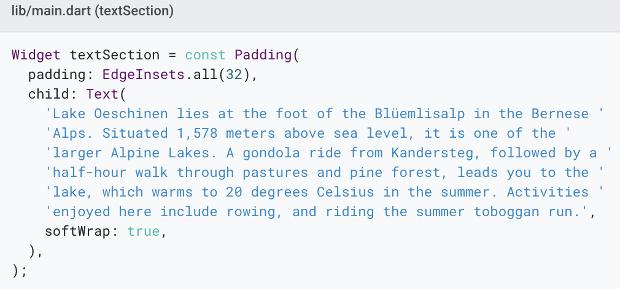
Step 4: Implement the text section
Define the text section as a variable.
Put the text in a Container and add padding along each edge.

Slide 12
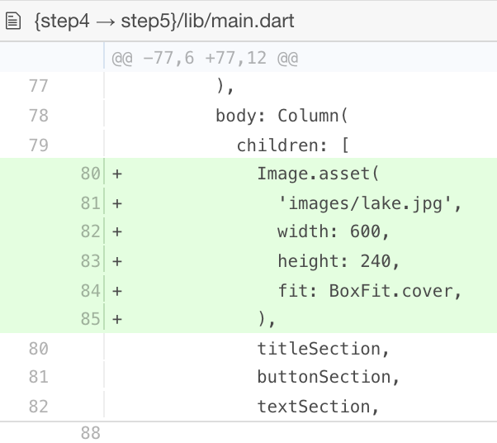
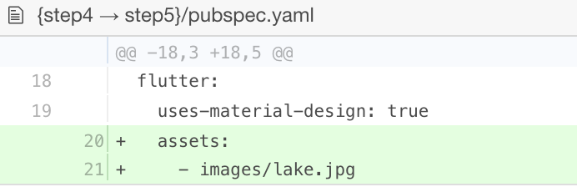
Step 5: Implement the image section
Create an images directory at the top of the project.
Add lake.jpg.
Update the pubspec.yaml file to include an assets tag.

Slide 13
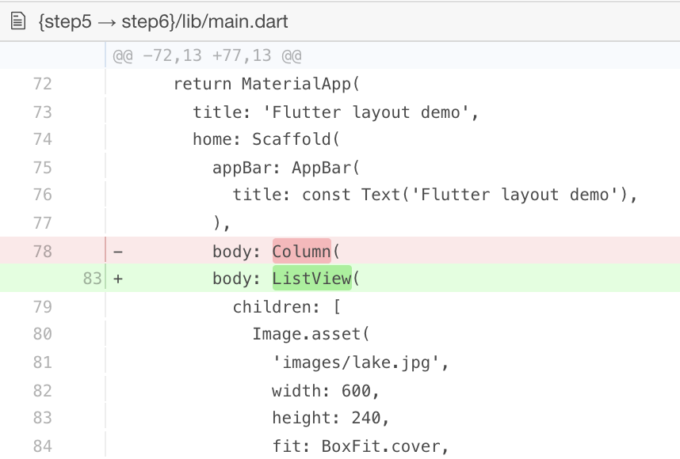
Step 6: Final touch
In this final step, arrange all of the elements in a ListView, rather than a Column, because a ListView supports app body scrolling when the app is run on a small device.

Slide 14
SourceCode
Dart code: main.dart
Image: images
Pubspec: pubspec.yaml

Slide 15
Tips
When pasting code into your app, indentation can become skewed. You can fix this in your Flutter editor using the automatic reformatting support.
For a faster development experience, try Flutter’s hot reload feature.
If you have problems, compare your code to lib/main.dart.
Note that pubspec.yaml is case sensitive.
The pubspec file is also sensitive to white space, so use proper indentation.
You might need to restart the running program (either on the simulator or a connected device) for the pubspec changes to take effect.

Slide 16
Thank you!
Wenxuan Shi
College of Software, Nankai University
Email: shiwx@nankai.edu.cn
Wechat: 13920561100

